Slide 1


Market Intelligence data delivered by the Nielsen Portfolio
prepared for Myungin Baek from Innocean Seoul on 20/04/2020
"Understand the advertising around you to improve your own"

Slide 2
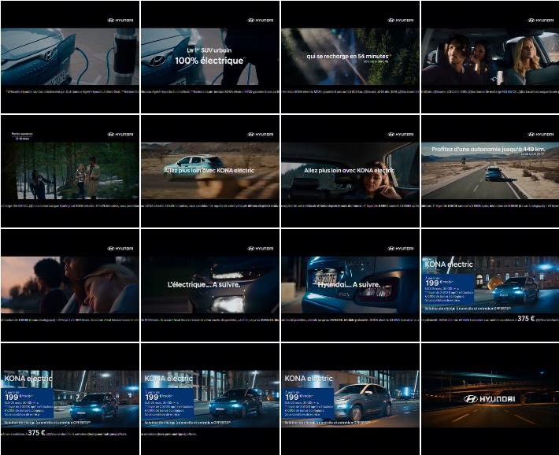
Hyundai Motors
Title: | Charges up in 54 minutes - open days
Media: | Television
Description: | Car on the road. The first 100% electric urban SUV. People exploring the forest. Up to 449 km autonomy. Free gift: home charger and servicing offered.
Country: | France
Product: | Kona electric offroader/SUV
Category (Full Hierarchy): | AUTOMOTIVE | Cars | Cars Offroad Vehicle/SUV/4x4
Date From/To: | 11/03/2020 - 16/03/2020
Channel: | L'equipe
Endline: | -
Creative ID: | 253246808

Slide 3
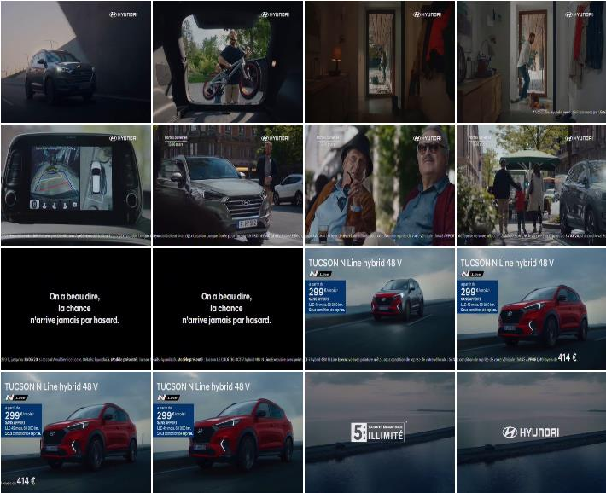
Hyundai Motors
Title: | Lucky man - N Line - open days
Media: | Television
Description: | Montage. Family man involved in various activities during the day. Finance offer: no deposit. Music: Evelyn Knight & The Ray Charles Singers - Lucky, Lucky, Lucky Me.
Country: | France
Product: | Tucson hybrid offroader/SUV
Category (Full Hierarchy): | AUTOMOTIVE | Cars | Cars Offroad Vehicle/SUV/4x4
Date From/To: | 09/03/2020 - 16/03/2020
Channel: | TFX
Endline: | -
Creative ID: | 253207208

Slide 4
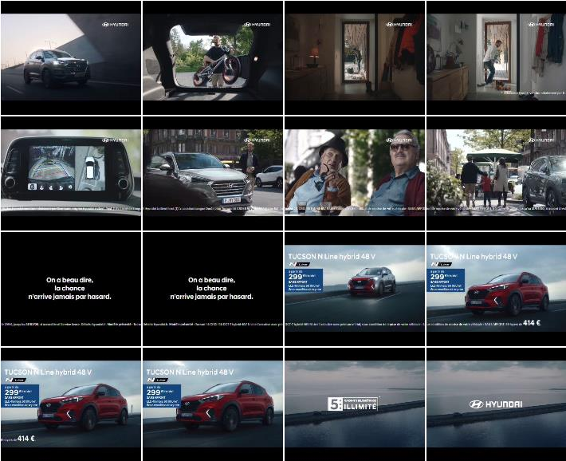
Hyundai Motors
Title: | Lucky man - N Line
Media: | Television
Description: | Montage of man doing various activities during the day. He is walking with his family. Finance offer: no deposit. Unlimited mileage. Limited time offer. Music: Evelyn Knight & The Ray Charles Singers - Lucky, Lucky, Lucky Me.
Country: | France
Product: | Tucson hybrid offroader/SUV
Category (Full Hierarchy): | AUTOMOTIVE | Cars | Cars Offroad Vehicle/SUV/4x4
Date From/To: | 02/03/2020 - 16/03/2020
Channel: | TF1 Series Film
Endline: | -
Creative ID: | 253022008

Slide 5
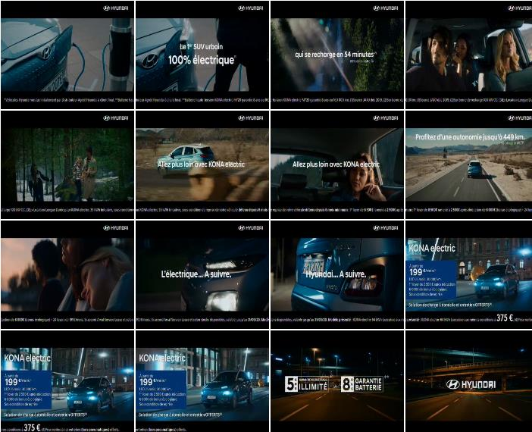
Hyundai Motors
Title: | Charges up in 54 minutes
Media: | Television
Description: | Car on the road. The first 100% electric urban SUV. People exploring the forest. Up to 449 km autonomy. Financial offer: 6,000 Euros cash savings and a monthly instalment starting at 199 Euros/month. Home charger and maintenance offered.
Country: | France
Product: | Kona electric offroader/SUV
Category (Full Hierarchy): | AUTOMOTIVE | Cars | Cars Offroad Vehicle/SUV/4x4
Date From/To: | 28/02/2020 - 16/03/2020
Channel: | L'equipe
Endline: | -
Creative ID: | 252940408

Slide 6

Hyundai Motors
Title: | Lucky man - N Line
Media: | Television
Description: | Montage of man doing various activities during the day. He is walking with his family. Price details, 5 years warranty, unlimited mileage.
Country: | France
Product: | Tucson hybrid offroader/SUV
Category (Full Hierarchy): | AUTOMOTIVE | Cars | Cars Offroad Vehicle/SUV/4x4
Date From/To: | 24/02/2020 - 16/03/2020
Channel: | M6
Endline: | -
Creative ID: | 252854708

Slide 7
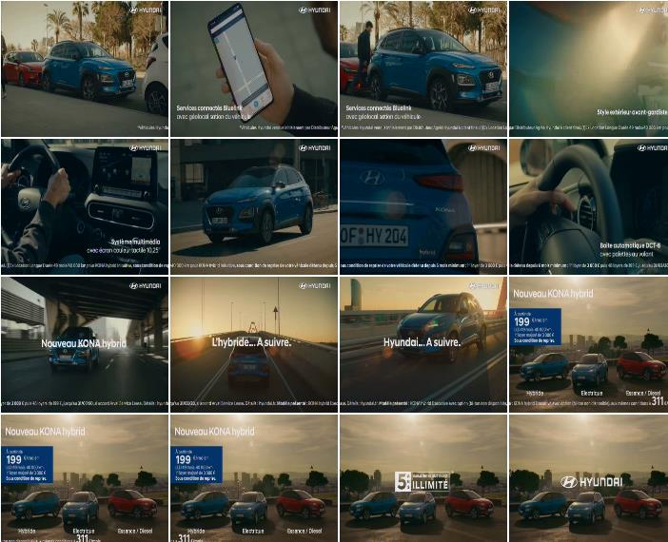
Hyundai Motors
Title: | Progress
Media: | Television
Description: | Man locating car thanks to application on smartphone and driving around a city. Exterior and interior of car being showcased. Outline of features. 5 years warranty. From 199 Euros/month.
Country: | France
Product: | Kona petrol & electric offroader/SUV range
Category (Full Hierarchy): | AUTOMOTIVE | Cars | Cars Offroad Vehicle/SUV/4x4
Date From/To: | 29/01/2020 - 17/03/2020
Channel: | TF1 Series Film
Endline: | -
Creative ID: | 252333908

Slide 8
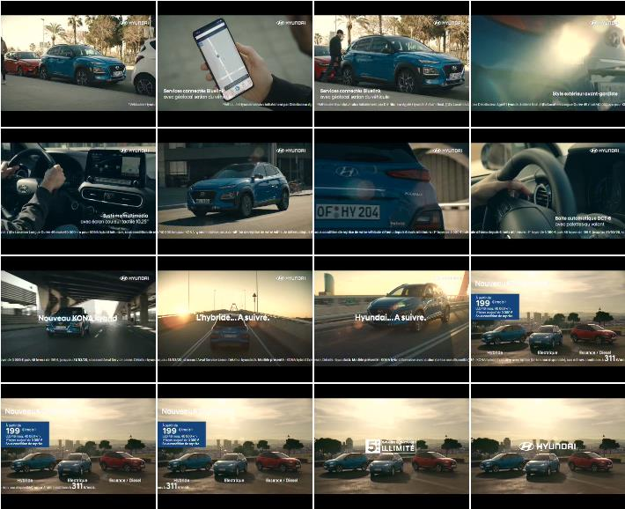
Hyundai Motors
Title: | Progress
Media: | Television
Description: | Man locating car thanks to application on smartphone and driving around a city. Exterior and interior of car being showcased. Outline of features. 5 years warranty. From 199 Euros/month.
Country: | France
Product: | Kona petrol & electric offroader/SUV range
Category (Full Hierarchy): | AUTOMOTIVE | Cars | Cars Offroad Vehicle/SUV/4x4
Date From/To: | 20/01/2020 - 19/03/2020
Channel: | TFX
Endline: | -
Creative ID: | 252050508

Slide 9

Hyundai Motors
Title: | Charges up in 54 minutes
Media: | Television
Description: | Car on the road. The first 100% electric urban SUV. People exploring the forest.
Country: | France
Product: | Kona electric offroader/SUV
Category (Full Hierarchy): | AUTOMOTIVE | Cars | Cars Offroad Vehicle/SUV/4x4
Date From/To: | 04/01/2020 - 13/03/2020
Channel: | Canal +
Endline: | -
Creative ID: | 251526108

Slide 10
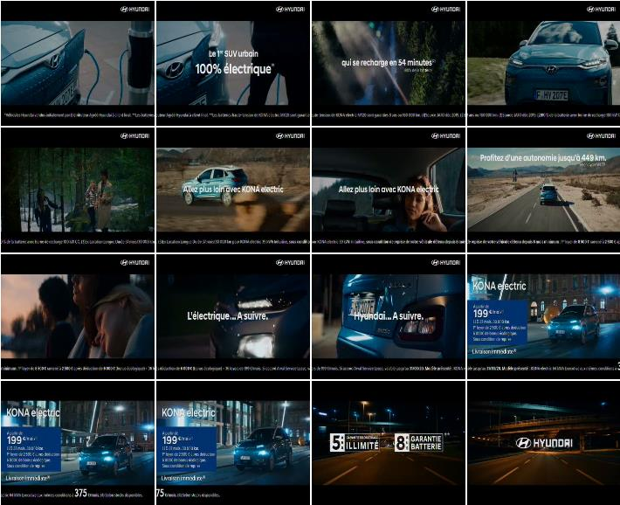
Hyundai Motors
Title: | Charges up in 54 minutes
Media: | Television
Description: | Car on the road. The first 100% electric urban SUV. People exploring the forest.
Country: | France
Product: | Kona electric offroader/SUV
Category (Full Hierarchy): | AUTOMOTIVE | Cars | Cars Offroad Vehicle/SUV/4x4
Date From/To: | 04/01/2020 - 14/03/2020
Channel: | BFM TV
Endline: | -
Creative ID: | 251462108

Slide 11
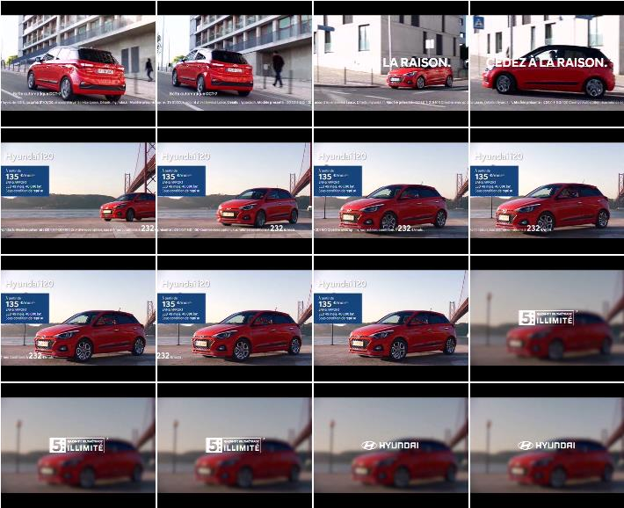
Hyundai Motors
Title: | Give in to reasonable
Media: | Television
Description: | Red vehicle on the streets. No deposit. 5 year guarantee, unlimited mileage.
Country: | France
Product: | i20 hatchback
Category (Full Hierarchy): | AUTOMOTIVE | Cars | Cars Compact
Date From/To: | 03/01/2020 - 19/01/2020
Channel: | Canal +
Endline: | -
Creative ID: | 251812508

Slide 12
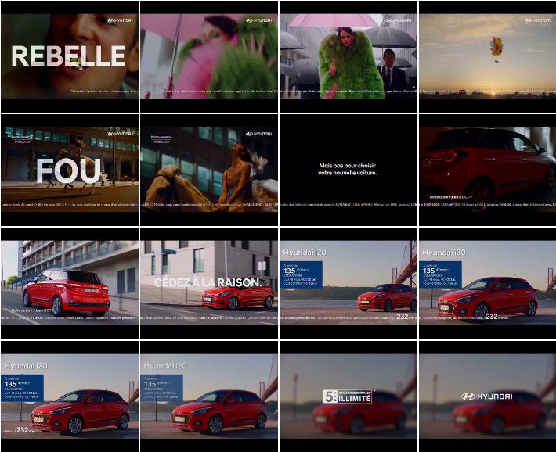
Hyundai Motors
Title: | Give in to reasonable
Media: | Television
Description: | People acting daring and crazy in the streets, only not when it comes to choosing a new car. Red vehicle on the streets. From 135 E per month. Savings under swappage condition. 5 year guarantee (unlimited mileage).
Country: | France
Product: | i20 hatchback
Category (Full Hierarchy): | AUTOMOTIVE | Cars | Cars Compact
Date From/To: | 02/01/2020 - 02/03/2020
Channel: | Canal +
Endline: | -
Creative ID: | 251896608

Slide 13
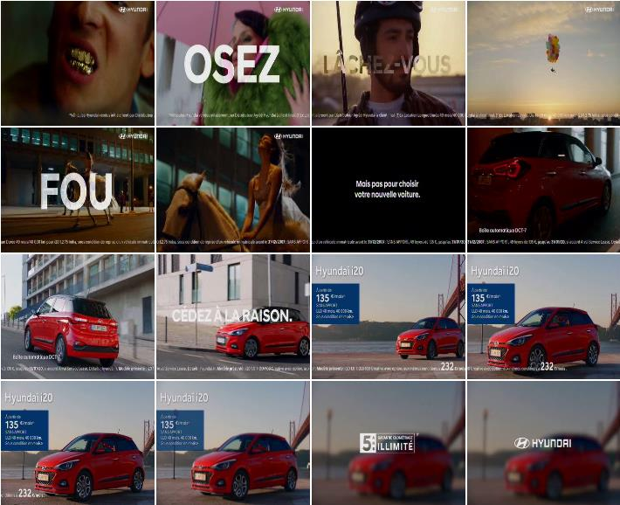
Hyundai Motors
Title: | Give in to reasonable
Media: | Television
Description: | People acting daring and crazy in the streets, only not when it comes to choosing a new car. Red vehicle on the streets. From 135 E per month. Savings under swappage condition. 5 year guarantee (unlimited mileage).
Country: | France
Product: | i20 hatchback
Category (Full Hierarchy): | AUTOMOTIVE | Cars | Cars Compact
Date From/To: | 02/01/2020 - 20/01/2020
Channel: | Canal +
Endline: | -
Creative ID: | 251586708

Slide 14
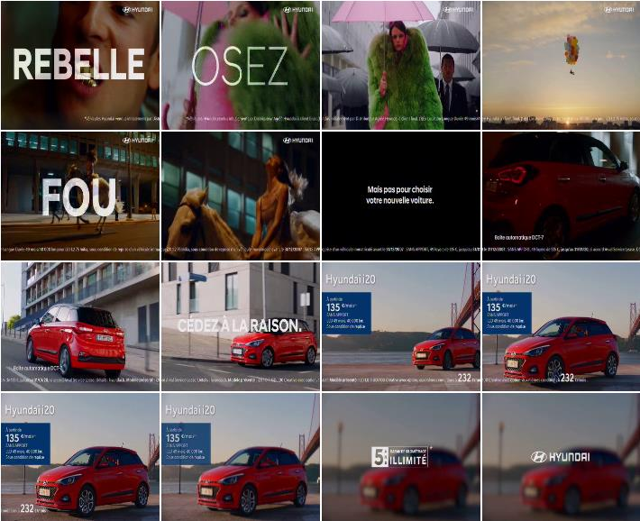
Hyundai Motors
Title: | Give in to reasonable
Media: | Television
Description: | Montage of people acting daring and crazy in the streets, but not when it comes to choosing a new car. Red vehicle on the streets. No deposit. 5 year guarantee, unlimited mileage.
Country: | France
Product: | i20 hatchback
Category (Full Hierarchy): | AUTOMOTIVE | Cars | Cars Compact
Date From/To: | 01/01/2020 - 20/01/2020
Channel: | L'equipe
Endline: | -
Creative ID: | 251425808

Slide 15
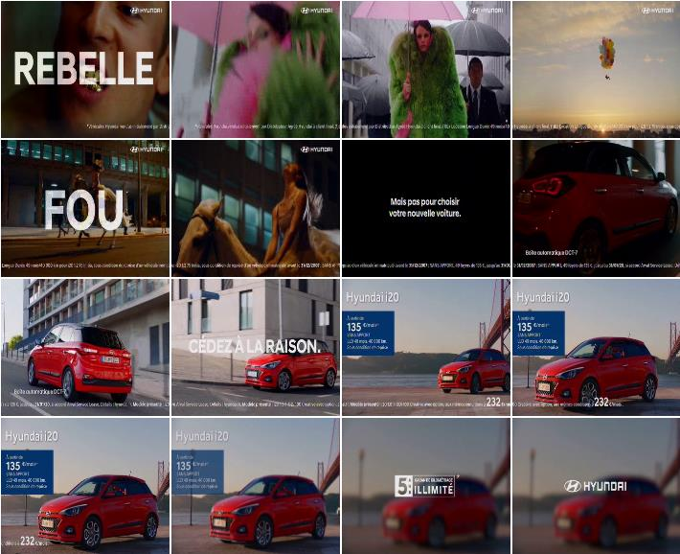
Hyundai Motors
Title: | Give in to reasonable
Media: | Television
Description: | Montage of people acting daring and crazy in the streets, but not when it comes to choosing a new car. Red vehicle on the streets. No deposit. 5 year guarantee, unlimited mileage.
Country: | France
Product: | i20 hatchback
Category (Full Hierarchy): | AUTOMOTIVE | Cars | Cars Compact
Date From/To: | 01/01/2020 - 21/01/2020
Channel: | C News
Endline: | -
Creative ID: | 251412008

